Slide 1

Subscriber Optimization for Rosetta Stone
Group 10: Brian Kim, Ishan Supanekar, Irene Huang, Jackie Zhao, Jun Jie Goh, Tim Tan

Slide 2
Data Exploration:
https://app.powerbi.com/groups/me/reports/6ee47567-7d32-4d41-ae31-25ab749a7cfb/ReportSection

Slide 3
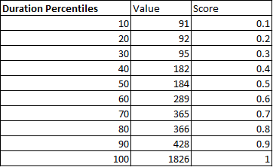
Most Valuable Subscribers
Overall Goal:
Identify our top percentile customers
Identify alike characteristics with top customers
Translate into business actions
Methodology:
Divide up the following categories as percentiles then score each value
Duration (difference of subscription end and start date)
Push Notifications
Open Rate (percentage of emails opened from Rosetta)
App Launch Count
Completion Count (number of times course was completed)
Aggregate the categories from a total score from 0-5
Label customers as “Champions” or high value if score ranged from 4-5

Slide 4
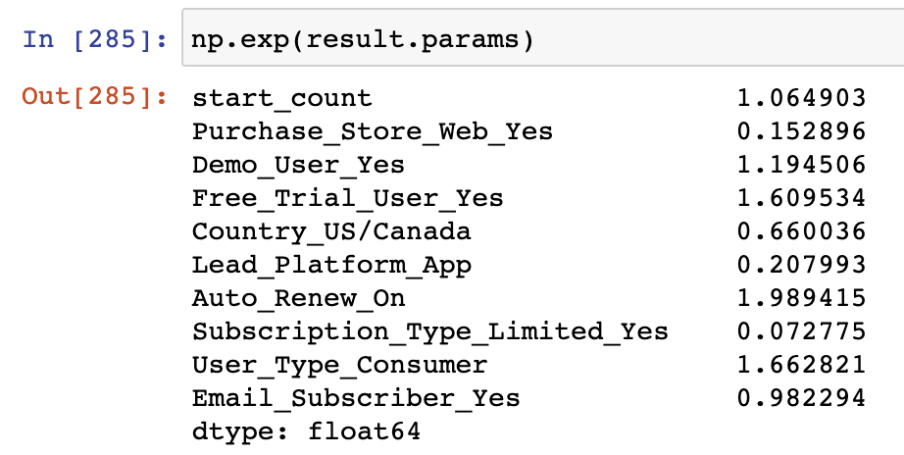
Most Valuable Subscribers Insights
Interpretation:
If user is had a free trial, they are 60% more likely to be a champion customer
If user have auto renew on, they are 98% more likely to be a champion customer
If user type is a consumer, they are 66% more likely to be a champion customer
Using these traits to mold future champion customers

Slide 5


Most Valuable Subscribers/Business Actions
Purpose: To keep our highly valued customers engaged and content with the service to avoid churn
Utilizing marketing campaigns / promotions specific to champions:
Offer a finite amount of free live tutoring sessions for highly valued customers
Refer a friend for one free Language-course
Special discounts for multiple Language plans

Slide 6
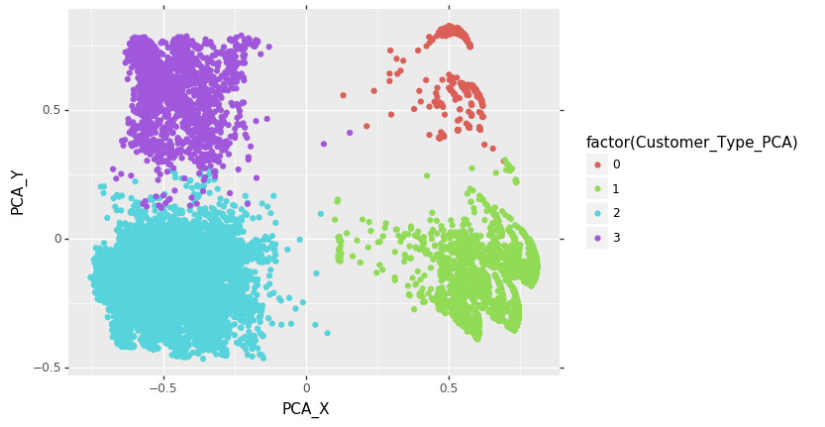
Subscriber Segments
Performed K-Means Clustering to create 4 segments
Graphed out each variables to analyze characteristics of segments
Number of Consumers
Segment 0: 2358
Segment 1: 8540
Segment 2: 11403
Segment 3: 2990

Slide 7
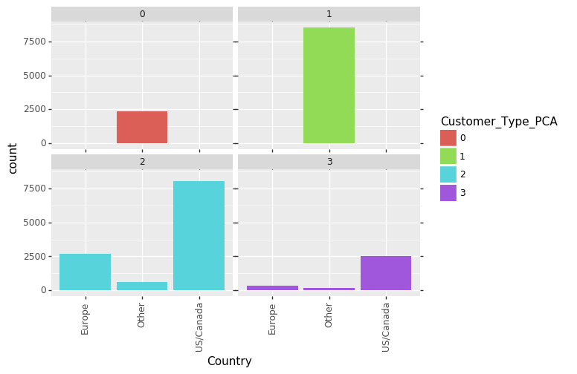
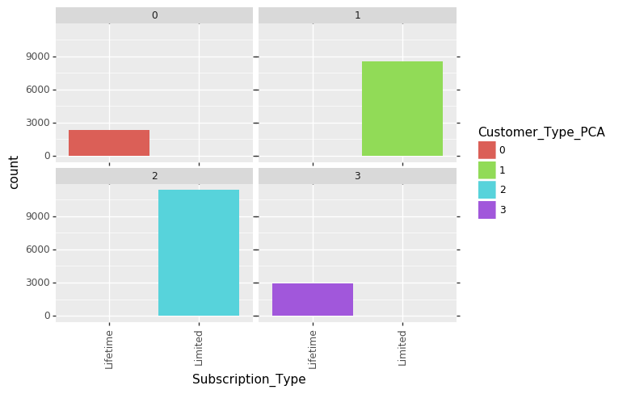
Understanding Each Segment
Segment 0: Non-Western, Lifetime Subscribers, Not very Involved
Segment 1: Non-Western, Limited Subscribers, Not Very Involved
Segment 2: Western, Limited Subscribers, Very Involved
Segment 3: Western, Lifetime Subscribers, Very Involved

Slide 8
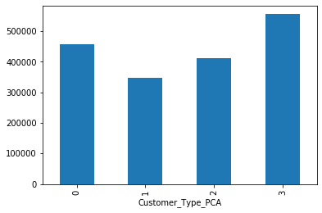
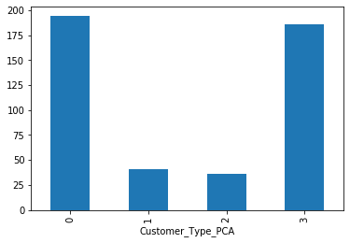
Analyzing Each Segment
Segments with Lifetime subscribers generate the most revenue
Highest average purchase amounts belong to those with Lifetime Subscriptions
Segments 1 & 2 have higher amount of consumers
Segments 1 & 2 also have more potential with renewals
Total Purchase Amount per Segment
Average Purchase Amount per Segment

Slide 9
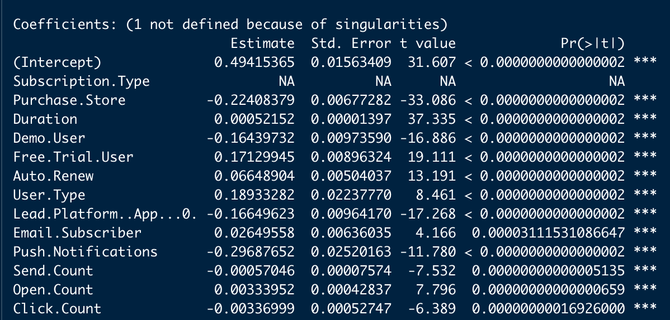
Subscribers with Most Potential
Overall Goal:
Identify subscribers with likelihood to purchase more products/services
Translate findings into business actions
Methodology:
Took out lifetime users since 30% of limited subscribers are renewals and no lifetime users renewed
Use both binary and continuous variables to predict Subscription Event Type
Convert binary variables to 0s and 1s
Take out variables that are categorical (not able to be used in linear probability model)
Find out top variables in predicting whether or not customer will resubscribe or is more likely to buy extra products in the future

Slide 10

Subscribers with Most Potential/Business Actions
Purpose: To keep selling our engaged customers content and new products/services
Target marketing ads towards individual consumers (not businesses) on mobile:
Individual consumers perform better than businesses in terms of re-subscribing
Customers who renew their subscription are more likely to buy new products/services
Special discounts for mobile users

Slide 11
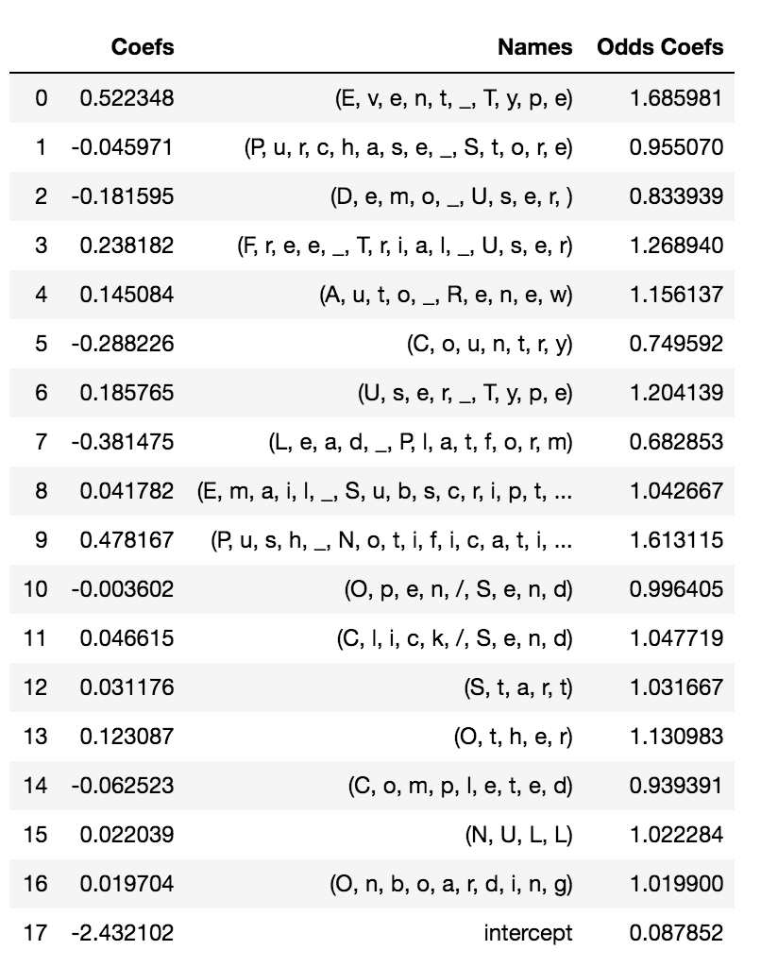
Subscriber Barriers: Methodology
Create variable “Quitter”
Expiration Date before August 2020
Take out duration that is around the multiple of 30 or repeats a lot
Define the remaining data as 1 for quitter
Remaining data from August 2020 are defined as 0 (non-quitter)
Logistic Regression
Only use data from before August 2020
Use “Quitter” as y variable
Accuracy: 90.29%

Slide 12
Subscriber Barriers: Insights
Subscriber profile of those stop using the product:
Event Type: Renew > Initial Purchase
Push Notification On
Free Trial User
User Type: Customer > Others
Insights:
To target more initial users, Rosetta Stone can have promotion and advertisement that specifically targets towards new customers
Provide a more customized content for subscribers who have notification on
Free Trial User are more likely to become quitters but are also more likely to become a champion user once they subscribe the product
Improve the transition process between free trial and an actual subscription to increase the amount of potential champion users

Slide 13
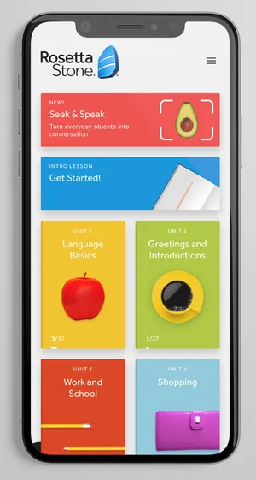
Additional Insights & Opportunities
Purpose: Explore and analyze optimized iOS App impacts throughout different time periods
Methodology
Divide App users into time periods based on Subscription Start Date
OldApp (10/1/18-1/30/19) - 4 months
NewApp (1/31/19-5/31/19) - 4 months
PreCovid1 (6/1/19-9/14/20) - 4.5 months
PreCovid2 (9/15/20-2/29/20) - 4.5 months
PostCovid (3/1/20-3/31/20) - 1 month
Metrics: App Activity, Subscription
Insights
NewApp: more users with higher engagement
Dip in engagement in following periods
Spike in new users due to COVID
Continue to invest marketing, R&D in App
Notes:
We discovered that Rosetta Stone released optimized App for iOS users around end of Jan 2019
So we wanted to explore and analyze the potential impacts the App has had on engagement
Methodology
PreApp: 4 month period of users that had the old app
PostApp: Users after the new App’s launch and we decided to make this a 4 months to compare with PreApp
Next 2 are PreCovid periods that are each about 4.5 months long
PostCovid: month long period when around when lockdown and stay-at-home orders began and ends at the most recent date in the dataset

Slide 14
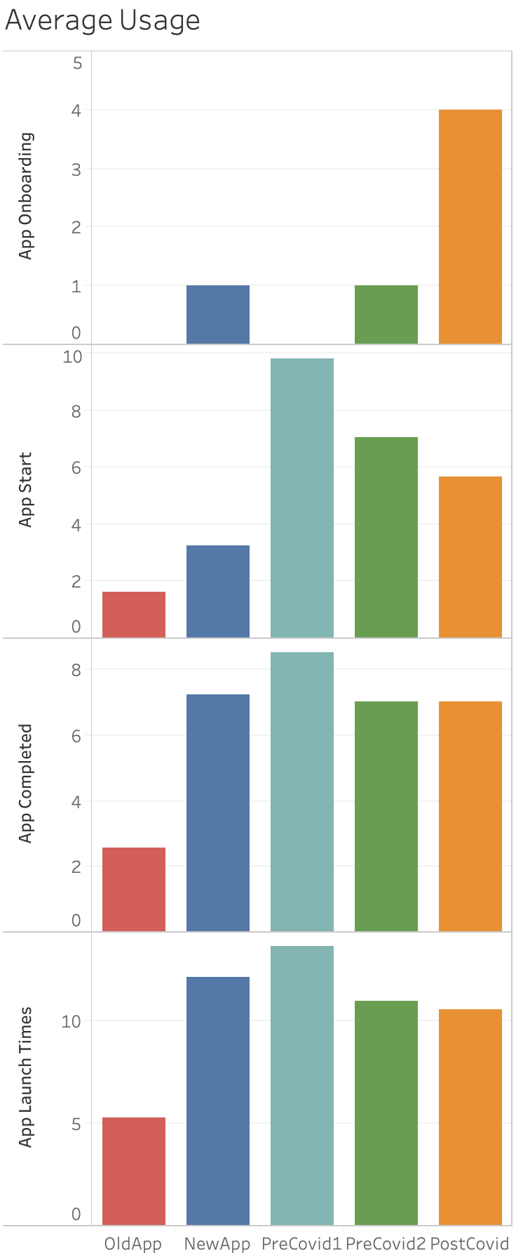
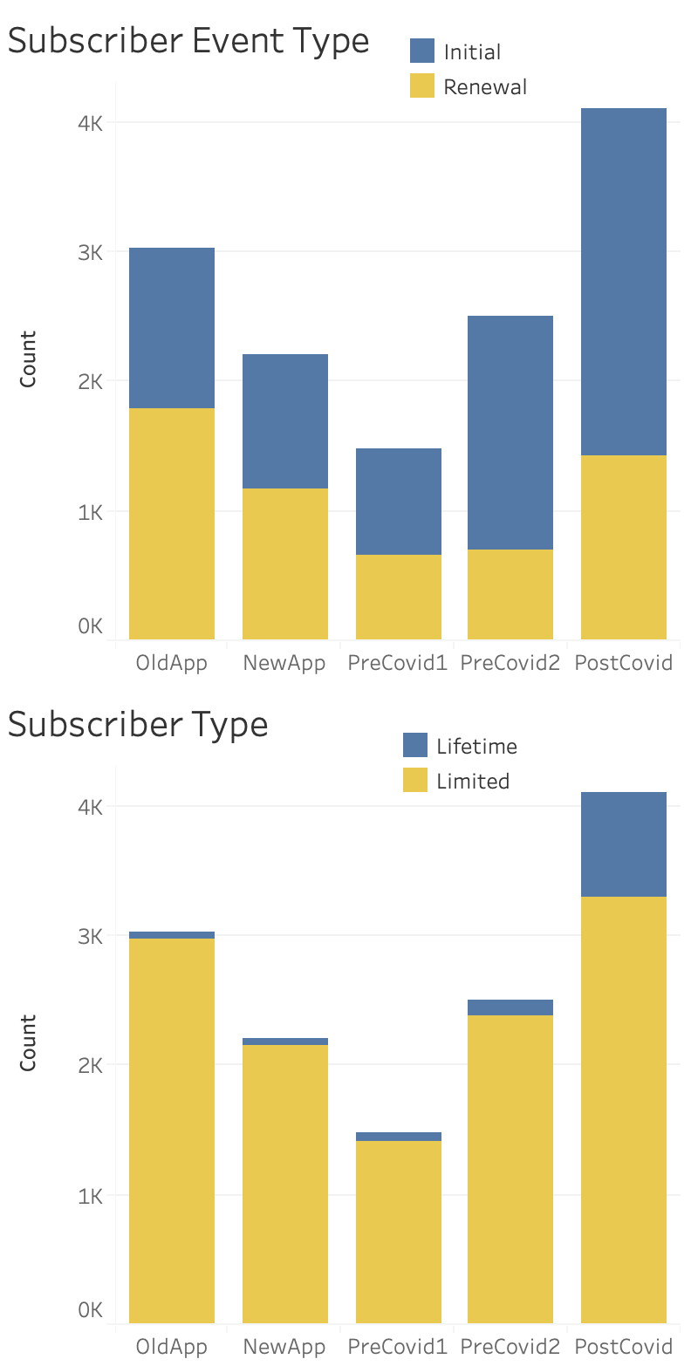
Additional Insights & Opportunities
OldApp vs. NewApp
Increased start, completion of lesson and overall engagement amongst App users
PreCovid vs. PostCovid
Spike in new users
Decreasing/stagnant start, completion, engagement rates
Initial vs. Renewal
Initial > Renewal over time
Lifetime vs. Limited
Little growth in Lifetime users until PostCovid period
Notes:
Average Usage Metrics extracted from App Activity so that we can take a closer glimpse at user engagement within App
PreApp vs. PostApp periods
Optimized App has brought in users as shown by spike in onboarding
AND increased overall engagement through the app
More users are starting and completing lesson plans as well as launching the app
PreCovid vs. PostCovid
Looking at the Onboarding average, we see a large spike in users right when lockdown and quarantine began
HOWEVER these new users aren’t engaged with the App since start/complete/launch times have pretty much stayed stagnant or even decreased
But this is likely because PostCovid period is only 1 month long, so users are still in the process of studying, which won’t be reflected in engagement metrics quite yet
What does this mean?
App is successful upon its first optimized release and has an even larger base now, so previously mentioned recommendations like special discounts for mobile users, customized marketing campaigns, etc. should be used to capture as much value as possible from these new users that have recently signed up
Subscription Metrics
Initial vs Renewal
Over time we see majority of subscribers renew shifted to initial purchases
Could be potential problem and poses a threat for Rosetta since renewers are more valued than initial purchasers
Lifetime vs. Limited
Over the last 4 precovid periods, there is very little growth in lifetime users
But after you can tell there is a significant increase in proportion of lifetime users to limited
Good: captured all the value from a larger population
Bad: tasked with the challenge of retaining limited users

Slide 15
Key Takeaways TL;DL
(Too long; didn’t listen)
Offer special marketing promotions / campaigns to “Champion” customers and customers with similar traits to keep them engaged
Segment 2 has the most potential for future purchases because they are limited subscriptions and have high interactivity rate
Customers who stay more active with the app in terms of app notifications tended not to renew their subscriptions
Improve transition process between free trial and actual subscription (ex. Better advertising or reminder) to increase the amount of potential champion users
The period immediately after the new App’s launch increased users and engagements, but engagement fell until resurgence due to COVID.

